Slide 1
Interactive Visual Data Analysis
02 – Criteria and influencing factors

Slide 2
Objectives
What makes a good interactive visual data analysis solution: Learn the criteria to be fulfilled
What do I need to take into account when designing, developing, or selecting interactive visual data analysis solutions: Learn about the influencing factors based on which decisions can be made

Slide 3
Overview
Criteria
Expressiveness
Effectiveness
Efficiency
Influencing factors
The subject: Data
The objective: Analysis tasks
The context: Users and technologies

Slide 4
Motivation
What makes a good visualization?
Map shows life satisfaction
0 unhappy – 10 very happy
Think about: What is the first impression conveyed by this visualization and what is truly contained in the data?
Notes:
First impression:
Eastern parts are unhappy
What’s contained in the data
People in Eastern parts are happy as well, but slightly less compared to Western parts

Slide 5
Motivation
What makes a good visualization?
Same data, different visual encoding
Think about: Which version is better?
Notes:
Left version is better because it faithfully encodes the underlying data.

Slide 6
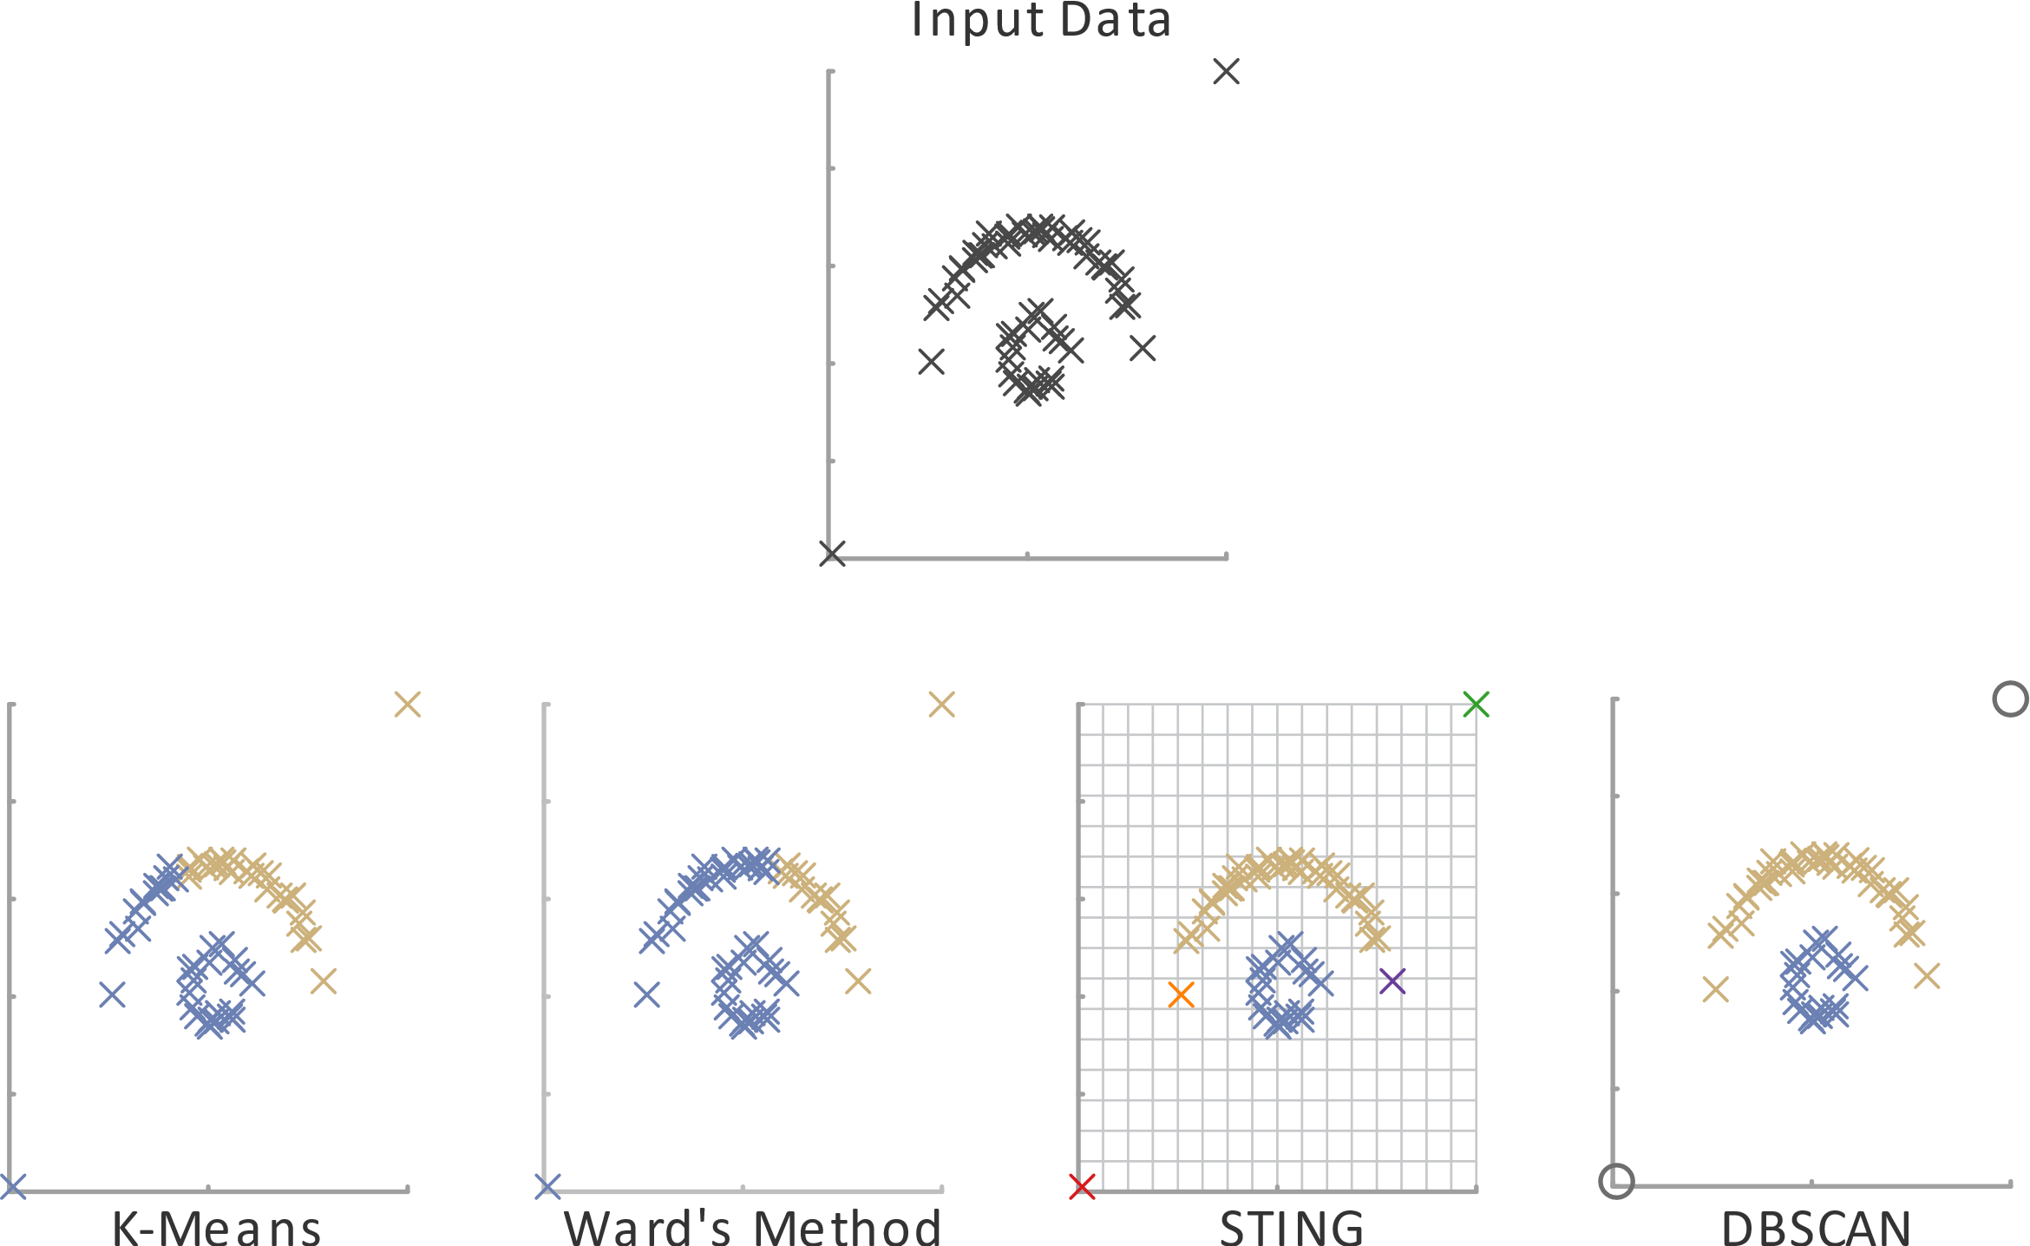
Motivation
Which computational method should be used?
Consider the plotted data
Four different algorithms computed data clusters
Think about: Which algorithm would you choose?

Slide 7
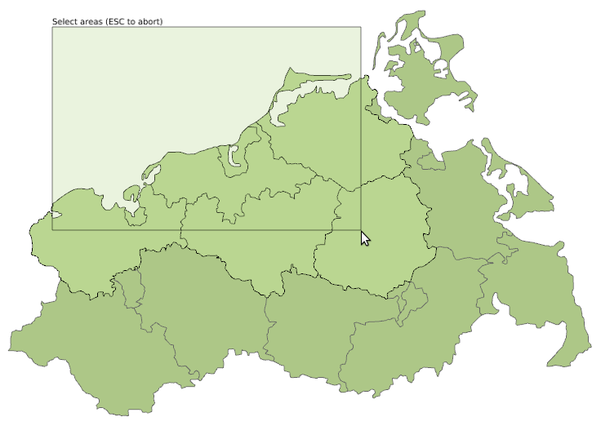
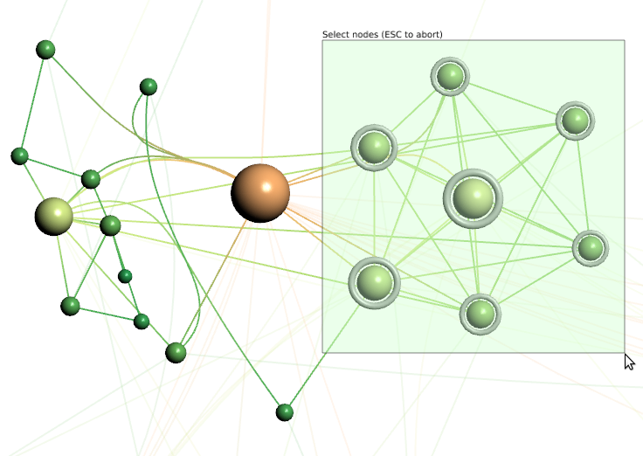
Motivation
Select by intersecting
How to interact with the data?
Two alternative interactions for selecting data items
Intersect: Select data items that intersect with rectangle
Include: Select data items that are fully included in rectangle
Think about: Which variant would you prefer?
Select by including

Slide 8
Criteria
We see that some solutions are seemingly better than others. To better characterize what makes a good solution, we define 3 quality criteria:
Expressiveness
Effectiveness
Efficiency

Slide 9
Criteria
Expressiveness
Relates to faithfulness
An interactive visual data analysis solution is expressive
if it communicates the relevant information contained in the data, and only this information. No information is fabricated, no information is withheld.
if it allows users to carry out the actions needed to acquire the desired information, and only these actions. Users are enabled to do exactly what is necessary for the task at hand.

Slide 10
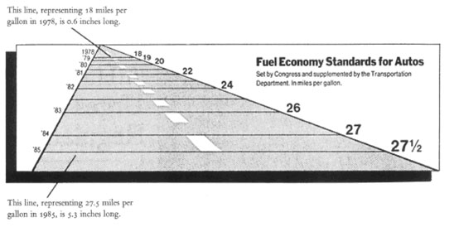
Criteria
Expressiveness: Lie Factor
Perceived effect $e_{v}$ should correspond to the effect in the data $e_{d}$
Lie factor $l=\frac{e_{v}}{e_{d}}$
Example:
$e_{v}=\frac{5.3−0.6}{0.6}=7.83≈783\%$
$e_{d}= \frac{27.5−18}{18}=0.53≈53\%$
$l= \frac{783\%}{52\%}=14.77$
Tufte, “The Visual Display of Quantitative Information”, Graphics Press, 2001
$$e_{i}=\frac{max−min}{min}$$
Also see https://www.vislies.org

Slide 11
Criteria
Effectiveness
Relates to the degree to which users can achieve tasks
An interactive visual data analysis solution is effective if it is geared to the human sensory and motor system
How well can users digest the depicted information (visual)
How well can users convey their intent to change (interactive)

Slide 12
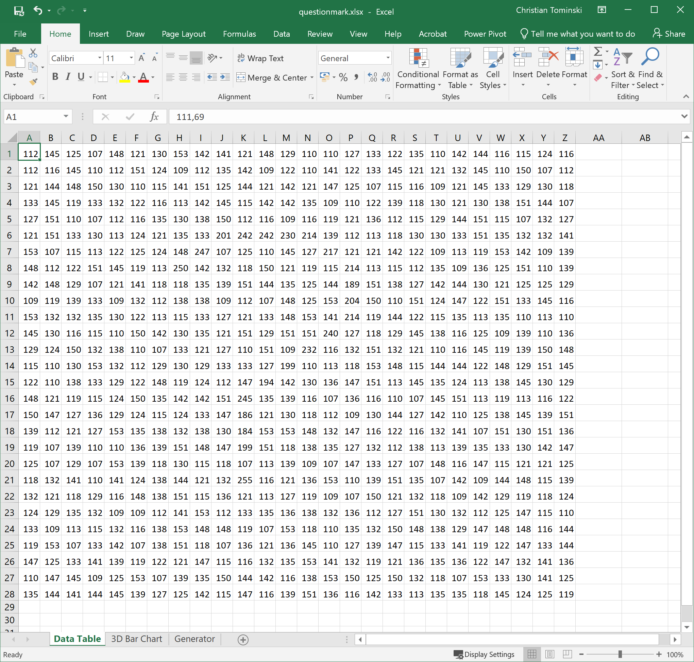
Criteria
Effectiveness: Illustrating example
Let’s visualize a data table!

Slide 13
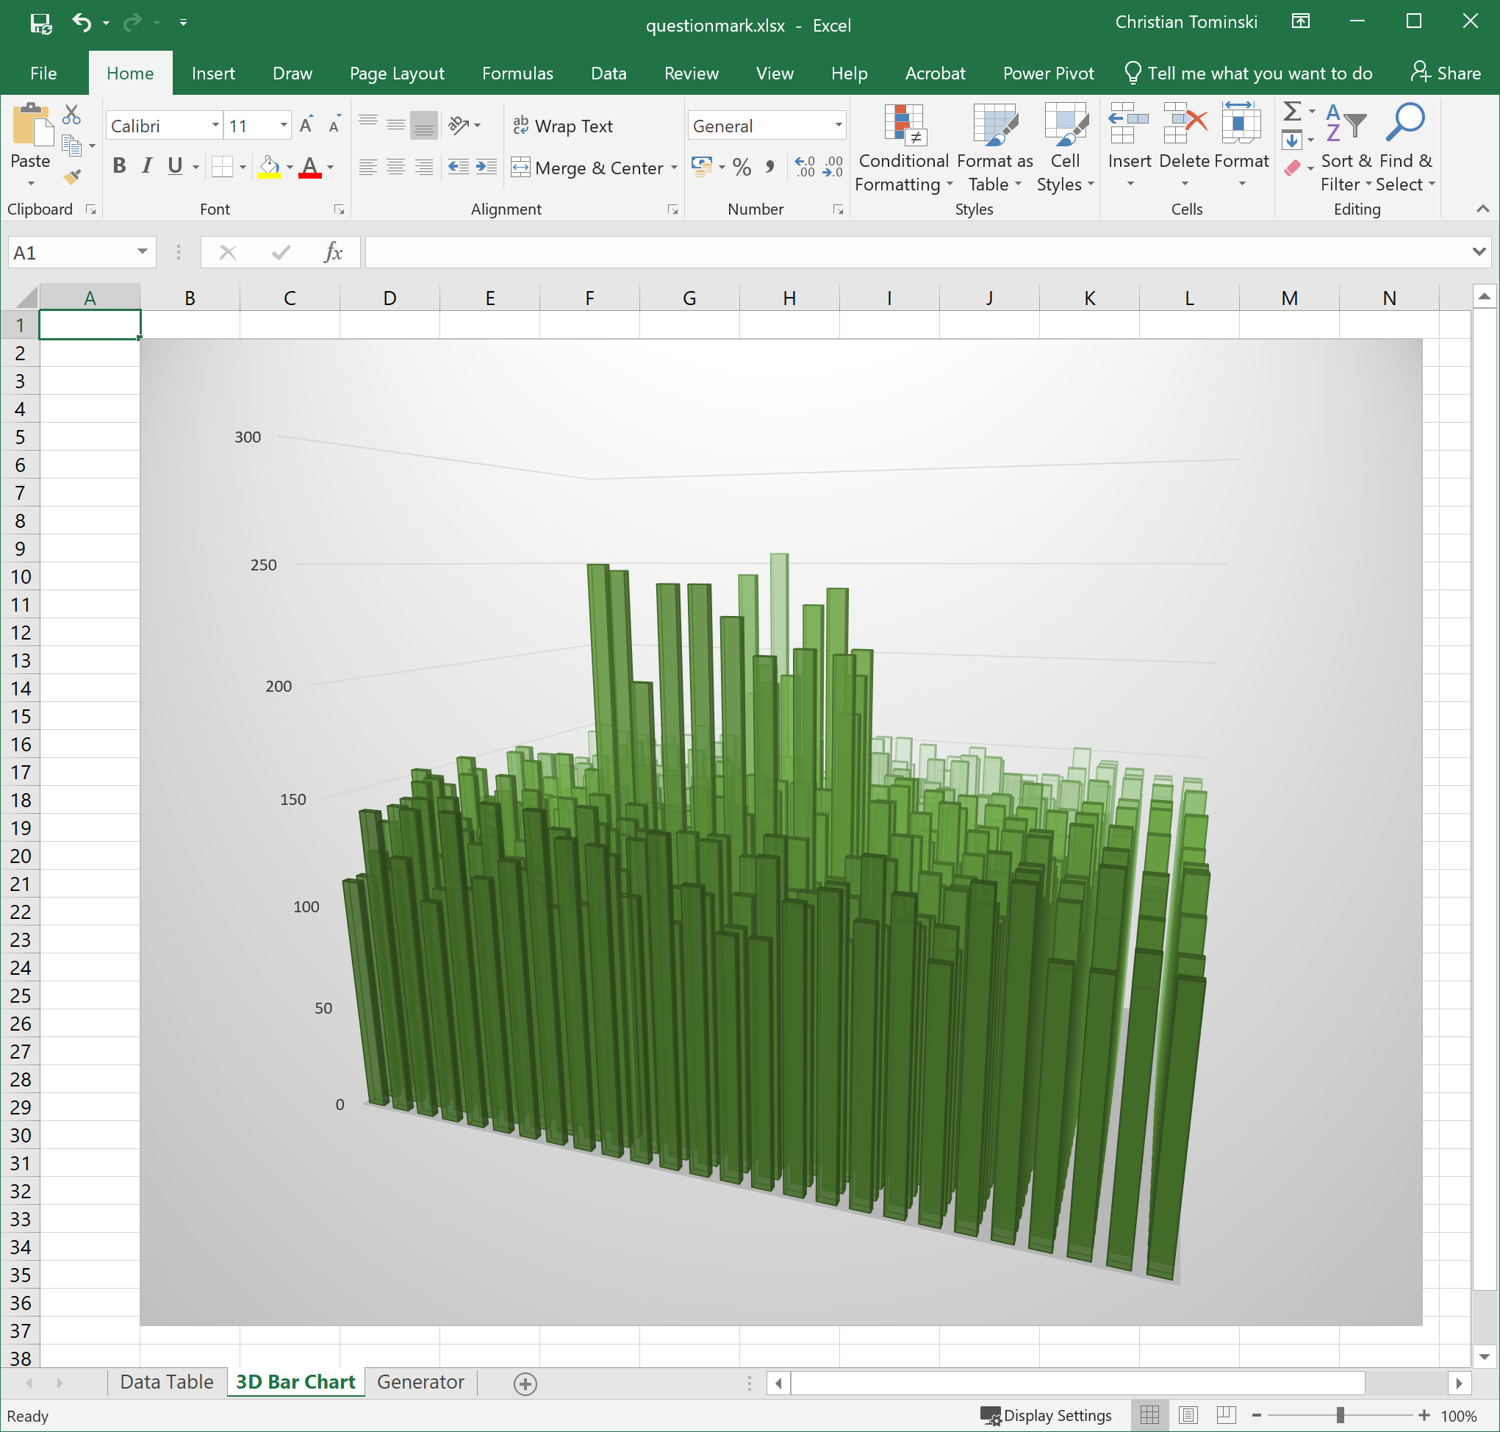
Criteria
Effectiveness: Illustrating example
Think about:
Is this visualization expressive?
Is this visualization effective?
Arguably, yes, it is expressive, because all data are represented visually?
But, it is not effective, because we can hardly interpret the data.

Slide 14
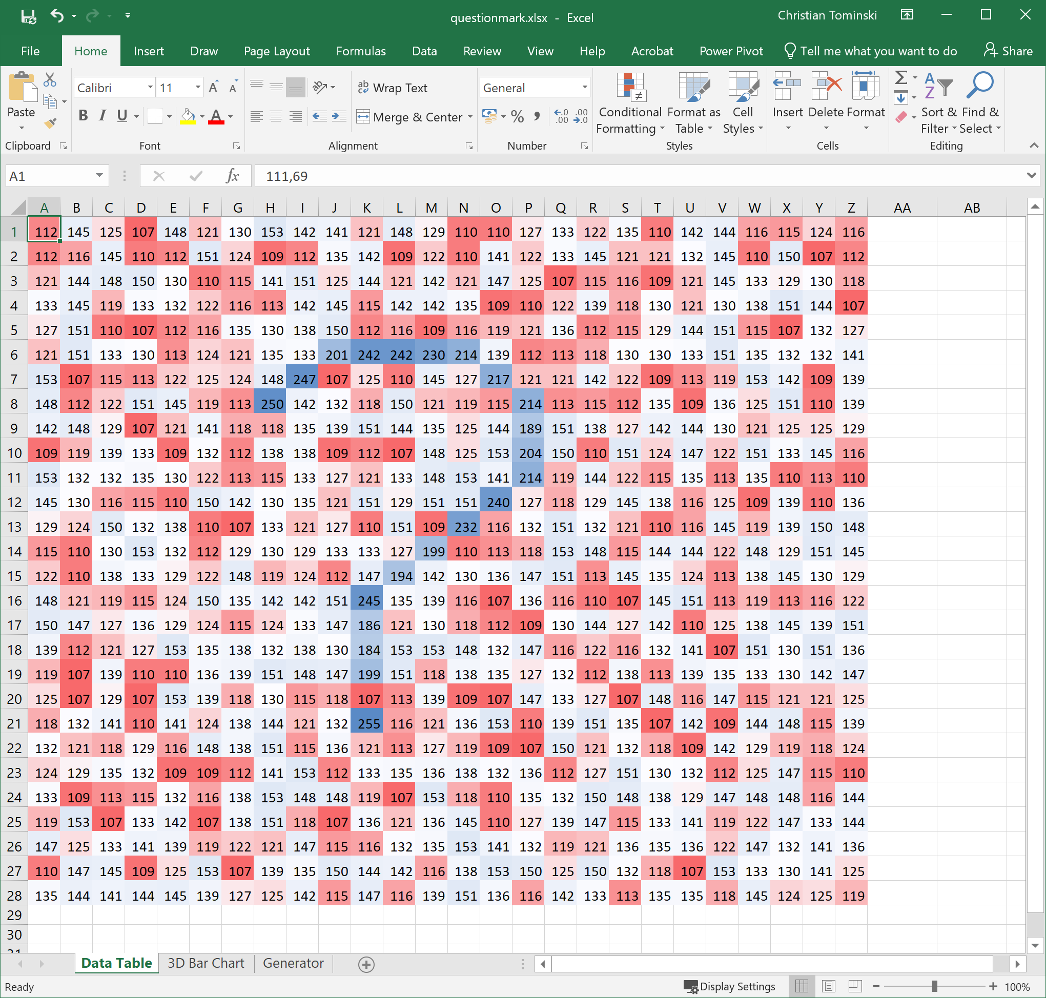
Criteria
Effectiveness: Illustrating example
Think about:
Is this visualization expressive?
Is this visualization effective?
Yes, expressive and effective! All data are depicted faithfully and we can easily discern a pattern from the otherwise noisy data.

Slide 15
Criteria
Efficiency
Relates to the balance of benefits and costs
An interactive visual data analysis solution is efficient if its benefits outweigh the costs in terms of computational and human resources
How much time and memory does it take?
How much display space is needed?
How much eye movement is required?
How long does it take to decipher the visual representation?
How difficult is it to interact?

Slide 16
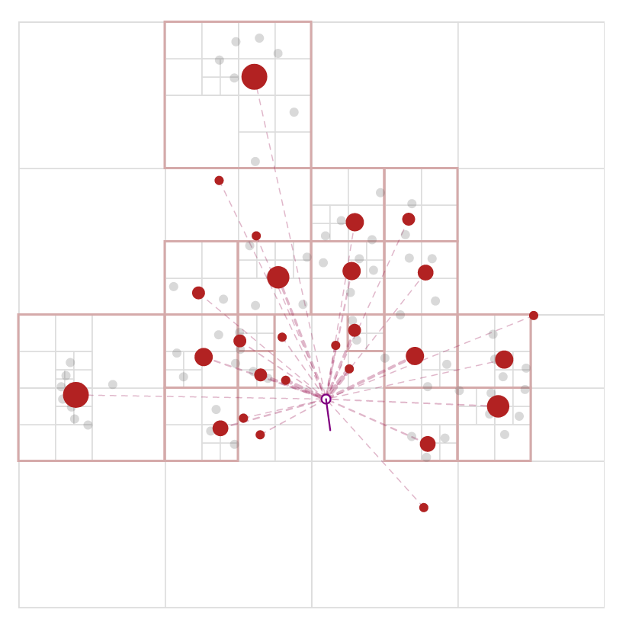
Criteria
Illustrating example: Efficiency
Force-directed layout for graph visualization
Attracting forces between connected nodes
Repelling forces between all nodes
Computational costs:
Naïve O(n²)
Barnes-Hut O(n log n)
https://jheer.github.io/barnes-hut/

Slide 17
Criteria
Criterion | Concern
Expressiveness | Faithfully map data and tasks
Effectiveness | Enable users to accomplish task
Efficiency | Balance benefits and costs
Discussion
Criteria capture conceptual ideas, and as such, are difficult to evaluate formally
Some aspects easy to quantify: Computation time, display space, …
Others hard to pin down:
Expressiveness: What is the “relevant” information to be depicted faithfully?
Effectiveness: How well can a complex data analysis system be operated?
Efficiency: What are the benefits of using an interactive visual solution?
Nonetheless, the 3 criteria provide essential guidelines for designing interactive visual data analysis solutions!

Slide 18
Criteria
Summary
“
Above all else show the data.
— Tufte, 1983

Slide 19
Influencing factors
When designing and developing interactive visual data analysis solutions, we need to take into account 4 key influencing factors:
Subject of the data analysis: Data (what)
Objective of the data analysis: Analysis tasks (why)
Context of the data analysis: Users and technologies (who, where, when)
Why do they matter?
Depending on the influencing factors, different design choices lead to different degrees of fulfillment of the 3 quality criteria!

Slide 20
Influencing factor: Data
With respect to the data, the following data characteristics are relevant
Data domain (data scale and data type)
Data structure
Data space
Data size
Data scope
Meta-data

Slide 21
Influencing factor: Data
Data domain
Set of values that a datum (or data value) can assume
Differentiate between different data scales and data types
Data scale: How are the data scaled?
Qualitative data: Nominal and ordinal data
Quantitative data: Discrete and continuous data
Data type: How is a datum composed of components?
Scalar, vector, tensor
Here, the notion of data type is used slightly differently from its use in programming languages.

Slide 22
Influencing factor: Data
Qualitative data
Nominal data
Values for which only the equality relation = is defined
Also called categorical data
Example: Names {John, Mike, Lisa, Monica}
Think about: Give another example of nominal data!
Ordinal data
Values for which an order relation < is defined in addition to equality
Example: Age groups {children, youths, adults, elders}
Think about: Give another example of ordinal data!
Notes:
Nominal data:
Hair color {blond, brown, black, red, gray}
ICD-10 diagnosis codes (more than 14.000) {A00.0 (Cholera), …, Z99.9 (Long-time dependency from medical apparatus)}
Ordinal data:
Level of education {Bachelor, Master, Doctor}
Satisfaction ranking {*, **, ***, ****, *****}

Slide 23
Influencing factor: Data
Quantitative data
Discrete data
Numeric values whose domain can be equated to the whole numbers
Countable and distance between any two data values is defined
Example: Number of people visiting a doctor
Continuous data
Numeric values whose domain can be equated to the real numbers
Uncountable, distance is defined, and interpolation is possible
Example: Temperature measurements
Think about: Why is the uncountable property of relevance here?
Notes:
Countable data can be transformed into a frequency representation. How many data item with a specific value?
For uncountable data this is not possible. We would need to assign continuous data values to a discrete number of bins first in order to be able to get a frequency representation.

Slide 24
Influencing factor: Data
Data scale
Summary of data scales and possible operations
Operations | Qualitative Data |  | Quantitative Data
 | Nominal | Ordinal | Discrete | Continuous
Equality | ● | ● | ● | ●
Order |  | ● | ● | ●
Distance |  |  | ● | ●
Interpolation |  |  |  | ●
(Count) | ● | ● | ●

Slide 25
Influencing factor: Data
Data type
Scalar:
Single value
Example: temperature value
Vector:
Magnitude and direction
Example: 3D vector flow vector
Tensor:
General multilinear transformations
Example: Rank-2, 3D stress tensor
In this lecture series, we will focus on scalar data.
$$36$$
$$\left(\begin{matrix}1 \\ 2 \\ 3\end{matrix}\right)$$
$$\left[\begin{matrix}4 & 5 & 6 \\ 8 & 10 & 12 \\ 12 & 15 & 18\end{matrix}\right]$$
Notes:
See https://www.youtube.com/watch?v=f5liqUk0ZTw and https://www.youtube.com/watch?v=uaQeXi4E7gA for a beginner’s guides to tensors.

Slide 26
Influencing factor: Data
Data structure
Raw data often “unstructured”
Data analysis typically requires transforming raw data to a suitable structure
Tabular data: Rows are tuples, columns are variables
Hierarchical data: Parent-child relations, e.g., for different levels of detail
Graph data: General model for entities and relations between them
(Grid-structured data: Data aligned on different types of grids, for 3D data)

Slide 27
Influencing factor: Data
Data space
Spanned by variables
Independent variables: Dimensions of the space where data have been collected, observed, or simulated
Dependent variables: Attributes of what has been collected, observed, or simulated
Describes a functional dependency
$$f:\left(D_{1}×D_{2}×…×D_{n}\right)→(A_{1}×A_{2}×…×A_{m})$$
A visualization usually has the goal to make the functional dependencies in the data visible

Slide 28
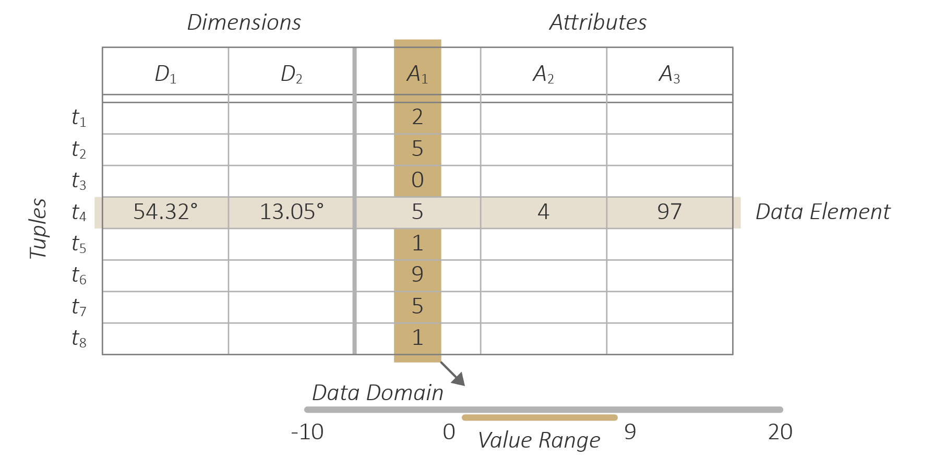
Influencing factor: Data
Data size
n - Number of dimensions
n-dimensional data
1D data (e.g., time-series): n = 1
2D data (e.g. geo-spatial data): n = 2
Think about: Any idea about 3D data?
Multidimensional data: n > 3
m - Number of attributes
m-variate data
Univariate data: m = 1
Bivariate data: m = 2
Multivariate data: m > 2
k - Number of tuples
Small data: k < 1000
Big data: k > 100.000

Slide 29
Influencing factor: Data
Fit the cloud
Fit on disk
Fit in RAM
Fit on screen
Fit the mind
Data size
Obviously, the larger m, n, and k are, the more difficult it will be to analyze the data
Requires additional effort for transforming, rendering, and interpreting the data
What are considered large data, depends on the application context
Sometimes a graph with hundreds of nodes is large, but graphs exist with millions of nodes!
Think about: Hardware barriers and data size

Slide 30
Influencing factor: Data
Data size
Interactive visual data analysis solutions usually target Big Data
Big Data characterized by five Vs
Volume: Many data points
Velocity: New data arrive at high speed
Variety: Many dimensions and attributes covering many different aspects
Variability: Data must be accessible to diverse user groups
Value: Monetary costs and benefits of data analysis are considerable

Slide 31
Influencing factor: Data
Data scope
Characterizes the range in which the data are valid around a point of observation
Usually cannot be inferred, must be given with the data description/context
Global scope Local scope Point scope

Slide 32
Influencing factor: Data
Data scope
For geo-spatial data, according to Tobler’s (1970) first law, the scope is local, because data measured at proximal locations tend to be correlated
So, (geo-)spatial data are likely to have local scope
Think about: How to represent local scope visually?

Slide 33
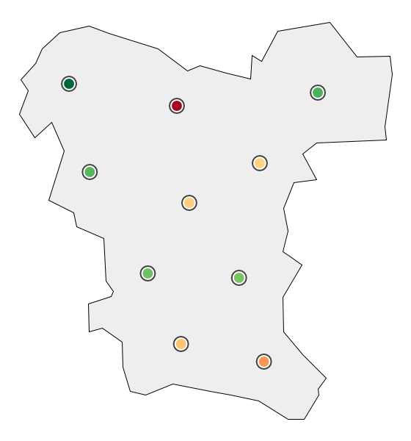
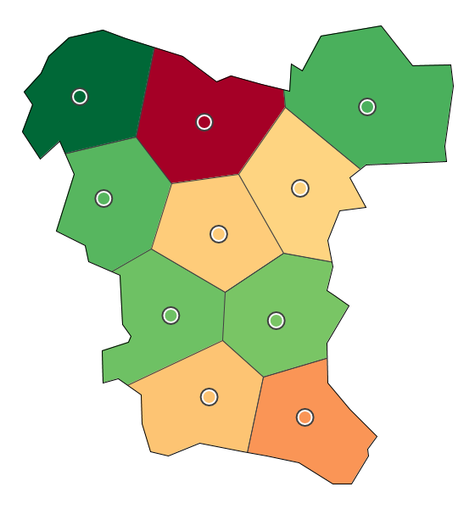
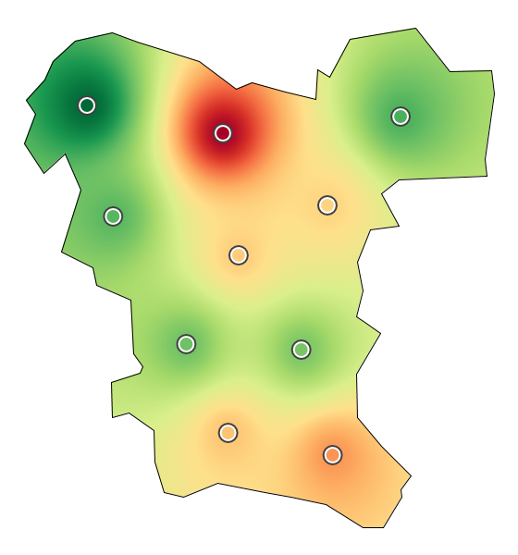
Influencing factor: Data
It is time for a demo!
Data scope
Points only Voronoi partition Scattered data interpolation
(invisible local scope) (discrete local scope) (continuous local scope)

Slide 34
Influencing factor: Data
Meta-data
Meta-data contain information about the actual data with respect to:
Data values: From which data domain are the values?
Data set: How is the dataset structured, how does the data space look like, how big are the data, what is their scope?
Data evolution:
Data Provenance: History of how the data were created?
Data Format: How are the data stored presently?
Data Utility: How may the data be used in the future?

Slide 35
Influencing factor: Data
Data classes
Data classes pertain to different data aspects
A – data attributes
T – time
S – space
R – structural relationships
Based on A, T, S, and R, different data classes can be defined
Multivariate data, temporal data, spatial data, spatio-temporal data, graph data, …

Slide 36
Influencing factor: Data
Data classes
Multivariate data (A)
Data with many attributes (A)
Product data, player statistics, gene expressions, simulation runs, etc.
Temporal data (T → A)
Data where attributes depend on time (T), a.k.a. time-dependent data
Financial data, medical treatment data, sensor data, etc.
Spatial data (S → A)
Data being located in space (S), a.k.a. geo-spatial data
Election data, distribution of places, land use, etc.

Slide 37
Influencing factor: Data
Data classes
Spatio-temporal data (S × T → A)
Data depends on space and time
Meteorological/climate data, disease spread, movement data, etc.
Graph data (R, R → A, R → S × T, or S × T → R × A)
Entities (vertices V) and relations (edges E) between them, graph G = (V, E)
Entities and relations may be associated with further information (A, S, T)
Social networks, biological pathways, connectome data, etc.

Slide 38
Influencing factor: Data
Data classes
Further data classes
Text (A, R)
Images (S, A)
Flow data (S, A)
Volume data (S, A)

Slide 39
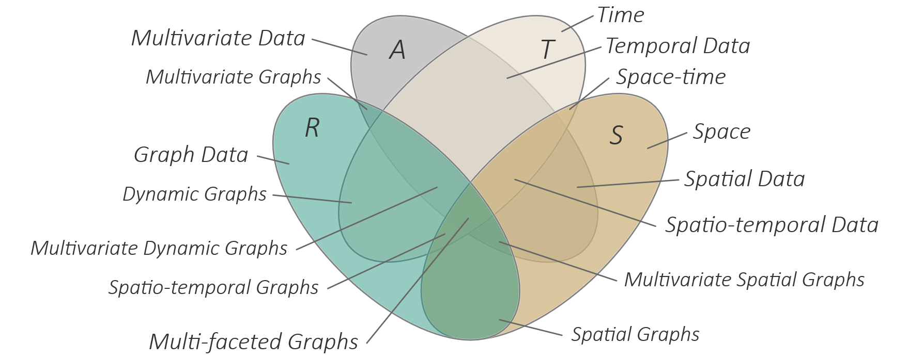
Influencing factor: Data
This type of visual representation is called a Venn-diagram.
Data classes

Slide 40
Influencing factor: Analysis tasks
With respect to the analysis tasks, the following aspects are relevant
Goals: Why do we carry out a task?
Analytic questions: What do we seek to answer?
Targets: Where in the data do we operate?
Means: How do we carry out the task?

Slide 41
Influencing factor: Analysis tasks
Goals: Why?
5 goals are primarily relevant for interactive visual data analysis
Exploration
Description
Explanation
Confirmation
Presentation
Goals roughly structure the analysis process
We start exploring the data and make observations. Next we describe findings and try to explain them. Then we confirm our hypotheses and finally present the confirmed analysis results.

Slide 42
Influencing factor: Analysis tasks
Goals: Why?
Exploration
Open-ended undirected search
“I-know-it-when-I-see-it” approach
Make first observations (e.g., gain overview, detect patterns and outliers, …)
Description
Characterize observations
Derive specifications for observations
Example: Describe outliers
What are their characteristic values?
Where are they located in space and time?
This goal very much relates to the classic idea of Exploratory Data Analysis as formulated by John W. Tukey, 1977.

Slide 43
Influencing factor: Analysis tasks
Goals: Why?
Explanation
Develop deeper understanding of observations (e.g., by identifying all contributing data, finding main causes, checking re-occurrence, etc.)
Formulate hypotheses about the data
Confirmation
Verify hypotheses
Look for concrete evidence to back up or refute hypothesis
Compare different subsets and different visual representations
Generate analysis results

Slide 44
Influencing factor: Analysis tasks
Goals: Why?
Presentation
Communicate confirmed analysis results
Best done by telling a story
Convince others
Think about: Who are we convincing in explanation and confirmation?

Slide 45
Influencing factor: Analysis tasks
Analytic questions: What?
Data analysis activities may involve a variety of analytic questions at two distinct levels
Elementary questions
Data elements are studied individually
May include one or more individual elements
Synoptic questions
Sets of data elements are studied
Consider sets as a whole, not individual elements

Slide 46
Influencing factor: Analysis tasks
Analytic questions: What?
Elementary questions
Identify: What is the value?
Locate: Where is the value?
Compare: Is it less or more?
Rank: Is there any order?
Connect: Are they related?
Distinguish: What makes the difference?

Slide 47
Influencing factor: Analysis tasks
Analytic questions: What?
Synoptic questions
Group: Do they belong together?
Correlate: Are there any dependencies?
Trends: Do they develop systematically?
Cycles: Do they re-occur periodically?
Outliers: Are they special with respect to the rest?
Features: What is characteristic for the data?

Slide 48
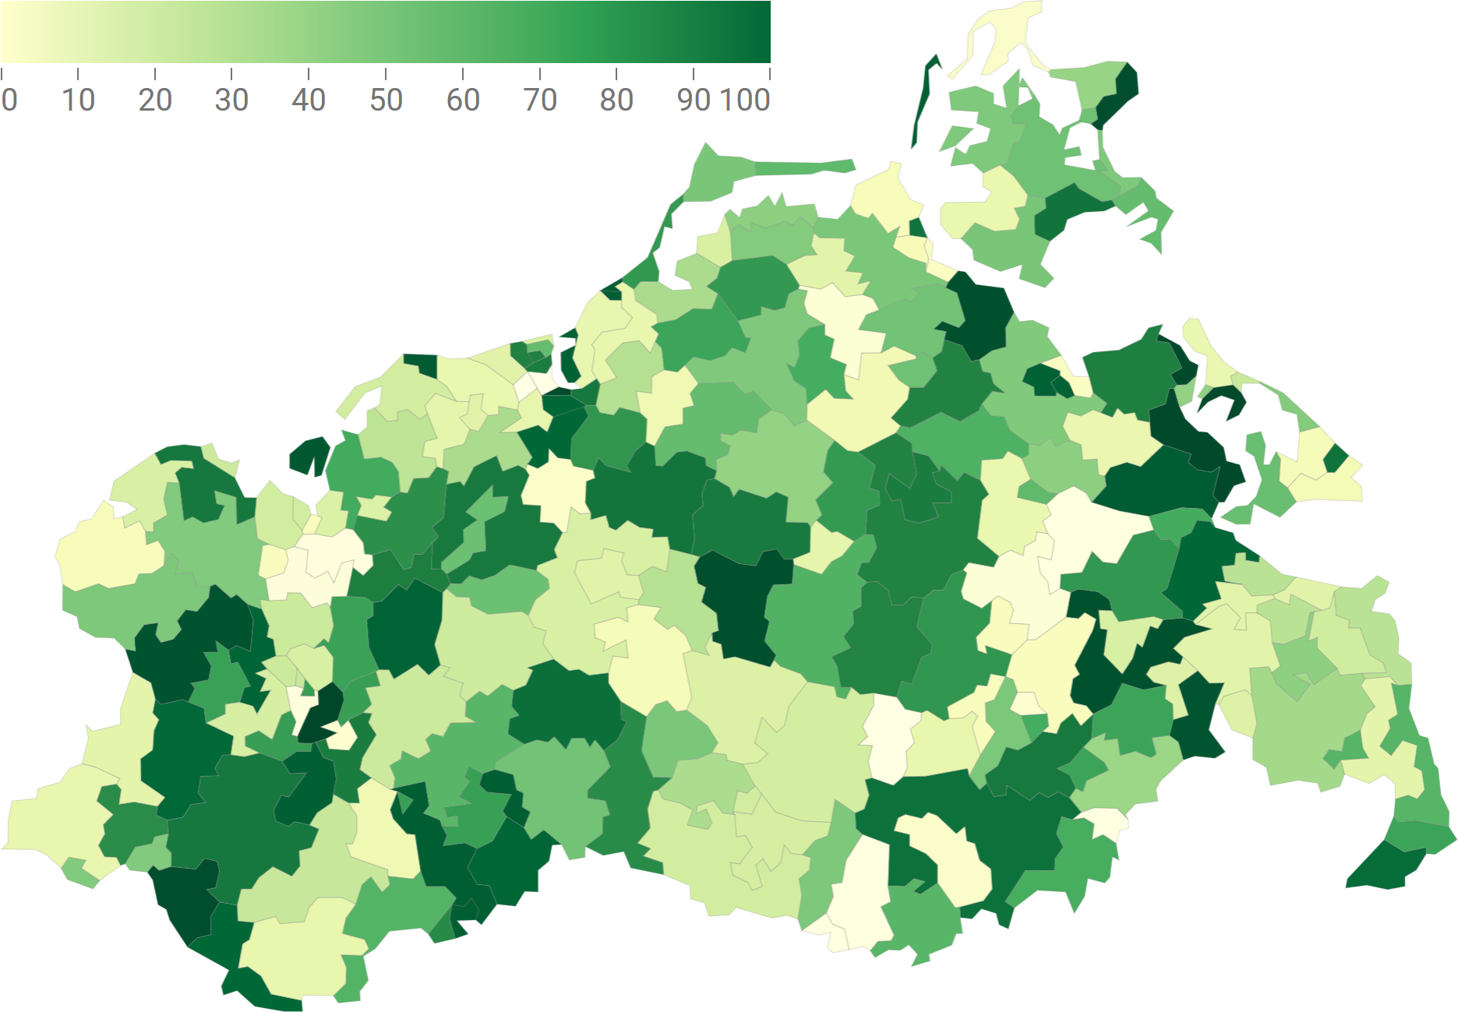
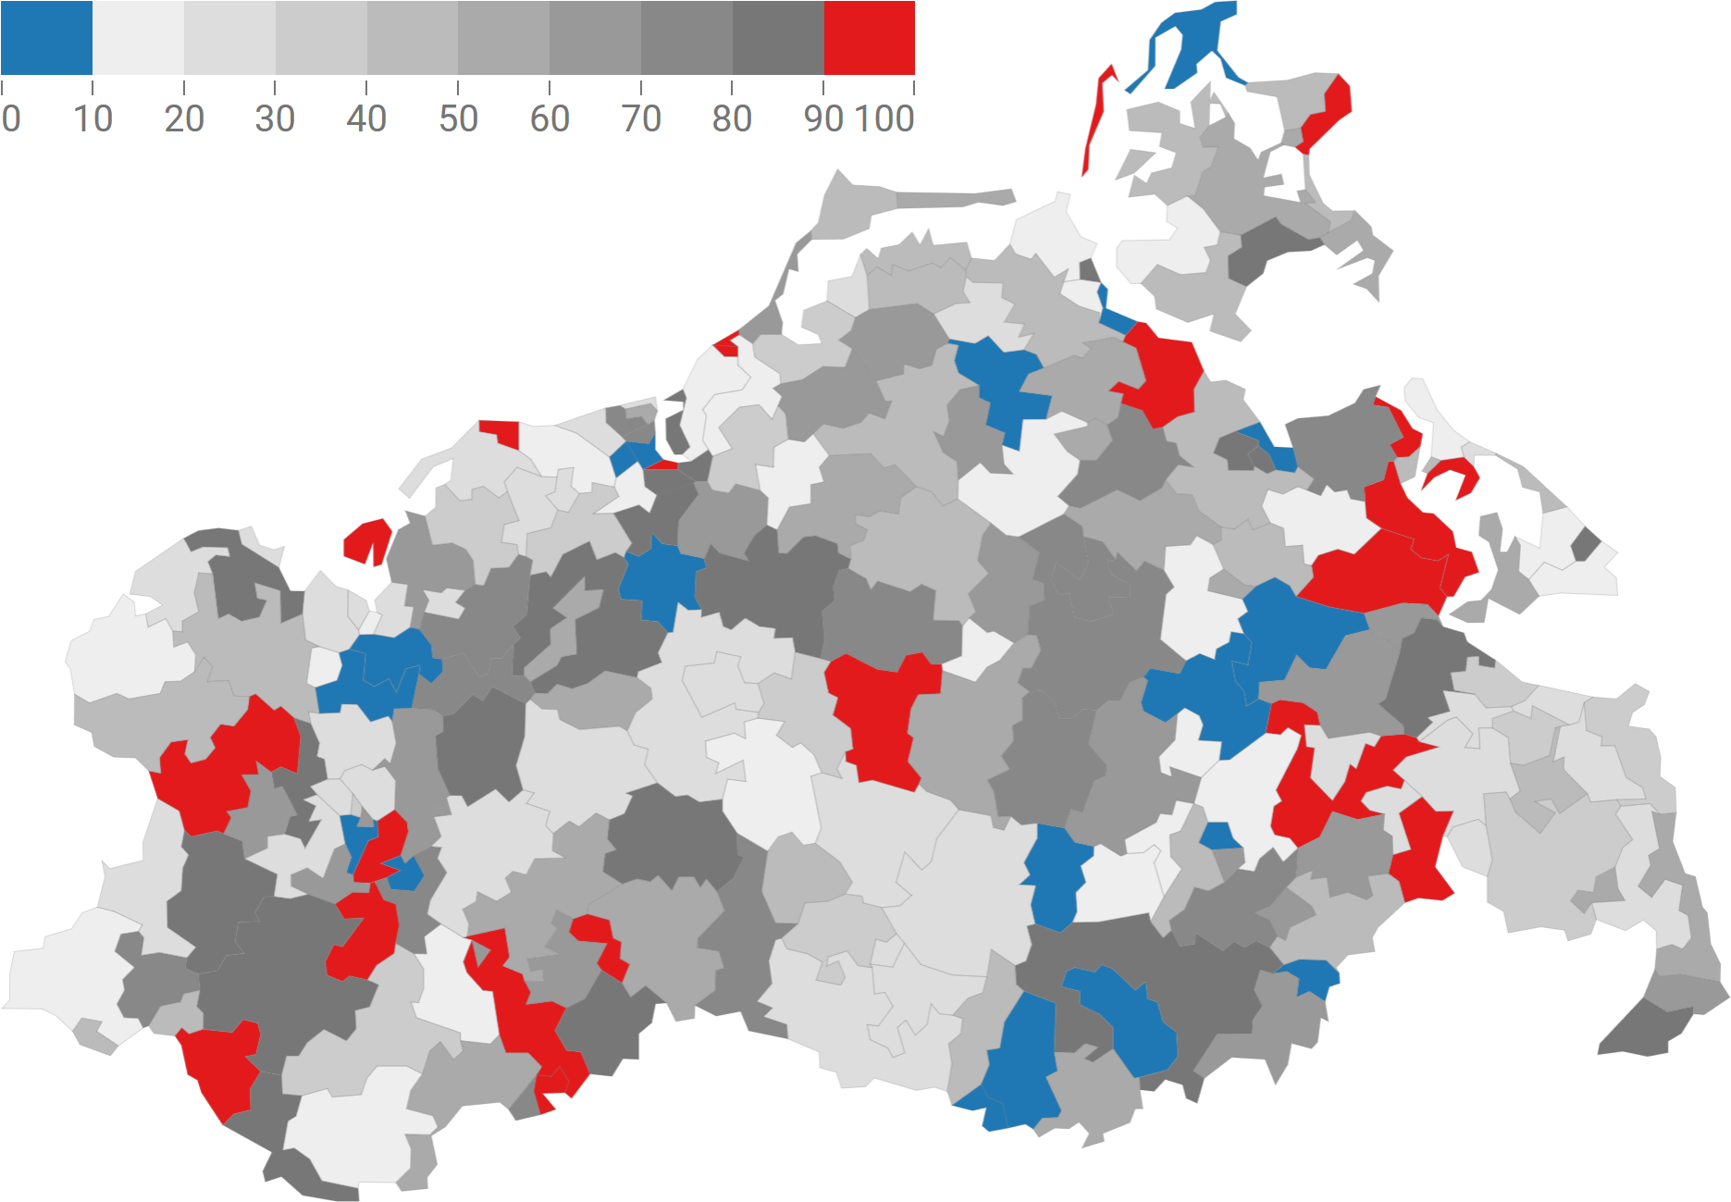
Influencing factor: Analysis tasks
Analytic questions: What?
Different questions require different visual representations
Example: Color-coded map for identification and location tasks
Emphasizing specific values in the color scale supports locating these values in the visualization
A uniform color scale supports identifying data values

Slide 49
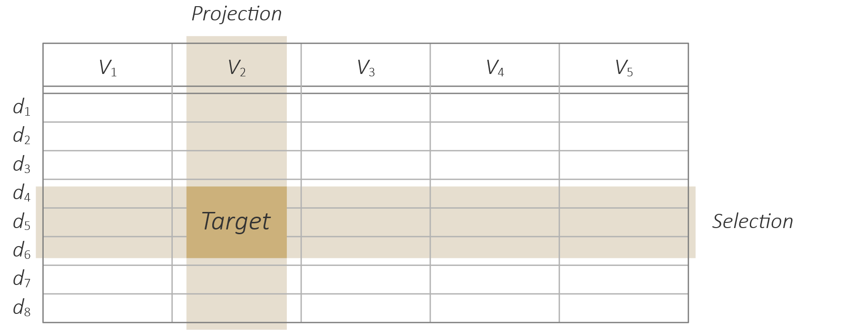
Influencing factor: Analysis tasks
Targets: Where?
Define where in the data a task operates
Knowing the target allows us to focus the analysis on relevant data
Data of interest
Particular data elements: Selection
Specific data attributes: Projection
Data granularity
Relevant for hierarchical multi-scale data
At what scale does a task operate
High level of abstraction: Overview tasks
High level of detail: Tasks required fine-grained information

Slide 50
Influencing factor: Analysis tasks
Means: How?
We have three options for carrying out analysis tasks
Visual means
Tasks rely primarily on the human visual system
Example: Detect group of similar data elements
Interactive means
Tasks are carried out primarily through human action
Example: Select data elements for detailed inspection
Computational means
Tasks conducted by the machine
Example: Cluster similar data elements

Slide 51
Influencing factor: Analysis tasks
Summary

Slide 52
Influencing factor: Analysis tasks
Examples
Goal | Question | Target | Means
Explore | locations of | maximum values | visually.
Describe | groups of | low-value elements | by marking.
Confirm | cyclic behavior | of temperature | by statistics.

Slide 53
Influencing factor: Context
The context captures the influencing factors pertaining to the users and the technologies involved in the data analysis
Users
Human factors
User background and expertise
Application domain
Single-user and collaborative analysis
Technologies
Computational resources
Display technologies
Input modalities

Slide 54
Summary
Criteria (few)
Expressiveness
Effectiveness
Efficiency
Influencing factors (many)
The subject: Data
The objective: Analysis tasks
The context: Users and technologies
The many influencing factors make the design of interactive visual data analysis solutions a challenging endeavor!

Slide 55
Summary
What can you do with criteria and influencing factors?
Assess the quality of an interactive visual data analysis solution!
Is the solution expressive, effective, and efficient?
Compare solutions based on criteria!
Is one solution more suited than another?
Ask your customers the right questions!
Are your data qualitative or quantitative?
How big are your data?
What are your goals?
Think about: What else might you want to ask?
Notes:
Other things to ask:
Data
Do you deal with scalars, vectors, or higher-order data?
How do you treat null or missing values?
Tasks
What do plan to do with your data?
Are you interested in sets of values or individual values?
Context
How experienced are the prospective users, experts or casual users?
How big are the screens on which the solution will run?

Slide 56
Assignments
Read about the context as influencing factor in detail in Chapter 2 of “Interactive Visual Data Analysis” by Tominski and Schumann!

Slide 57
Questions
Name and explain the 3 quality criteria for interactive visual data analysis!
What can we learn from the “lie factor”?
What factors influence design and selection of adequate methods?
How is the data domain characterized?
What are independent and dependent variables and how are they related to the reference space and the attribute space?
Name different data classes and give corresponding example data sets!
Name and explain the 5 primary goals of interactive visual data analysis!
How are elementary and synoptic analysis questions characterized? Give examples tasks!
How can identification tasks and location tasks be supported by appropriate color-coding?
What are selection and projection good for?
What is captured by the context as an influencing factor?
What would you sensibly ask a customer who approaches you with a data analysis project proposal?

